Slide 1
Statistics Introduction and Sampling Methods
To be introduced to the content of the statistics component of A level mathematics
To be able to recognize the importance of sampling
To be able to define keywords in sampling
To begin to recognize the different sampling methods

Slide 2
Statistics Component:
Year 1 | Year 2
Collecting, Representing and Interpreting Data: Sampling Central Tendency and Spread Single Variable Data Bivariate Data | Probability and Continuous Random Variables: Conditional Probability Modelling with Probability The Normal Distribution Normal Distribution to approximate the binomial
Probability and Discrete random variables Probability Binomial Distribution | Hypothesis Testing: Testing Correlation Testing the Normal Distribution
Hypothesis Testing: Formulating a test The Critical Region
Large Data Set – Family Food

Slide 3
The Data Cycle
From your KS3 and GCSE knowledge – if you wanted to do research for a statistical project what aspects would you need?
Why do we need data in today’s world? What key industries use data?

Slide 4
The Data Cycle

Slide 5
Sampling Key Words
Population
Finite Population
Infinite Population
Census
Sample
Parameter
Statistic

Slide 6
Sampling Key Words
Population – The whole set of things you are interested in
Finite Population – The number of teachers in a school
Infinite Population – The range of locations an archers arrow may land
Census – Information is collected from the whole population
Sample – The subset of the population
Parameter – A number that describes the whole population
Statistic – A number taken from a single sample

Slide 7
Finite or Infinite?
The grain of sands on a beach
The 2016 Olympic gold medals
The stars in the Milky Way galaxy
Cells in a human body
Chili plants on sale at the local garden centre

Slide 8
Census or Sample?
Marcel is in charge of a packaging department of 8 people. He wants to know the average number of items a person packs each day.
A toy manufacturer produces batches of 500 toys. They need to do a safety check, testing the toys on the strength needed to pull them apart
Tara has a biased dice. She wants to find the proportion of dice rolls that will result in a ‘3’

Slide 9
An Example:
Nina is doing a survey on whether people buy ethically-sourced products. She asked her mother to hand out to 20 of her friends.
What is the advantages and disadvantages of this sample?

Slide 10
Why do we take samples?

Slide 11
Why do we take samples?
The population of interest is usually too large to attempt to survey all of its members.
A carefully chosen sample can be used to represent the population.
So how could we sample?

Slide 12
Random Sampling
Random sampling is the purest form of probability sampling.
Each member of the population has an equal and known chance of being selected.
When there are very large populations, it is often ‘difficult’ to identify every member of the population, so the pool of available subjects becomes biased.

Slide 13
Systematic Sampling
Systematic sampling is often used instead of random sampling. It is also called an Nth name selection technique.
After the required sample size has been calculated, every Nth record is selected from a list of population members.
As long as the list does not contain any hidden order, this sampling method is as good as the random sampling method.
Its only advantage over the random sampling technique is simplicity (and possibly cost effectiveness).

Slide 14
Stratified Sampling
Stratified sampling – with key groups in the population, samples are taken from each group in proportion to their size and how they represent the population.
is commonly used probability method that is superior to random sampling because it reduces sampling error.
Stratified sampling is often used when one or more of the groups in the population have a low incidence relative to the other groups.

Slide 15
Convenience/Opportunity Sampling
Convenience sampling is used in exploratory research where the researcher is interested in getting an inexpensive approximation.
The sample is taken from the population that is available to you, until you have the desired sample size
The sample is selected because they are convenient.
Can be seen as biased samples

Slide 16
Quota Sampling
Quota sampling is the nonprobability equivalent of stratified sampling.
First identify the groups and their proportions as they are represented in the population
Then convenience sampling is used to select the required number of subjects from each group.

Slide 17
Cluster Sampling
Cluster sampling Population is split into clusters that you expect to be similar to each other, then a sample is taken from each
Similar to stratified sampling
Then convenience sampling is used to select the required number of subjects from each group.

Slide 18
Can you list the whole population?

Slide 19
Can you list the whole population?
Yes | No
Simple Random Sampling | Opportunity Sampling
Systematic Sampling | Quota Sampling
Stratified Sampling | Cluster Sampling

Slide 20
Sample Size?
The more heterogeneous a population is, the larger the sample needs to be.
Depends on topic – frequently it occurs?
For probability sampling, the larger the sample size, the better.
With nonprobability samples, not generalizable regardless – still consider stability of results

Slide 21
So now you have your sample size, how can you collect it?

Slide 22
Response Rates
About 20 – 30% usually return a questionnaire
Follow up techniques could bring it up to about 50%
Still, response rates under 60 – 70% challenge the integrity of the random sample
How the survey is distributed can affect the quality of sampling

Slide 23
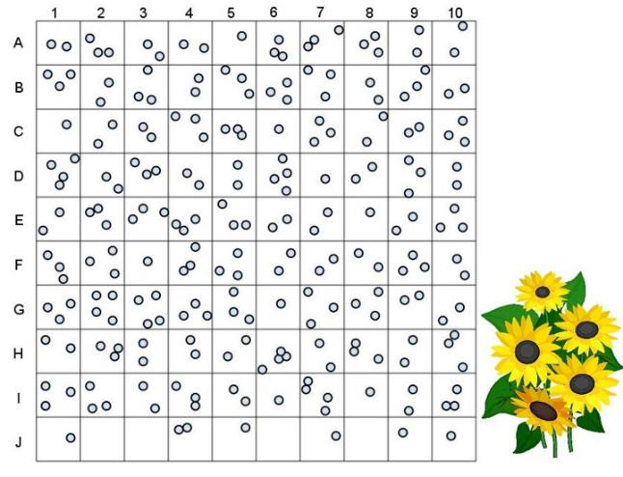
Random Sampling A
We want a sample of 10 segments to show the distribution of sunflowers per square metre.
What is the average?

Slide 24
Random Sampling B
1 | 2 | 3 | 4 | 5 | 6 | 7 | 8 | 9 | 10
11 | 12 | 13 | 14 | 15 | 16 | 17 | 18 | 19 | 20
21 | 22 | 23 | 24 | 25 | 26 | 27 | 28 | 29 | 30
31 | 32 | 33 | 34 | 35 | 36 | 37 | 38 | 39 | 40
We need to conduct a survey on 20% of the population of the 6th form.
Use the random number tables to identify your sample.

