Slide 1
Vectors – Equation of a Line.
y
Vectors can be used to describe points, lines and planes in 2D and 3D.
Suppose you have a line which passes through a point with position vector a and is parallel to vector b.
The general point on this line will have position vector r where
r = a + λb
λ is a scalar quantity and determines how far along the line you move.
b
a
r
x

Slide 2
r = a + λb
is the vector equation of a line which passes through the point with position vector a
and which is parallel to vector b.

Slide 3
If the position vector a = (a₁, a₂, a₃)
the direction vector b = (b₁, b₂, b₃)
and the position of a general point is r = (x, y, z)
then we have:
x = a₁ +λb₁
y = a₂ +λb₂
z = a₃ +λb₃
then it follows that:
λ = $\frac{x−a1}{b1}$ = $\frac{y−a2}{b2}$ = $\frac{z−a3}{b3}$
These are the Cartesian Equations of the line.

Slide 4
The Cartesian equations of a line are
$\frac{x−3}{2}$ = $\frac{y+1}{4}$ = $\frac{z−2}{−5}$
Give the vector equation of the line.
Position vector = $\left(\begin{matrix}3 \\ −1 \\ 2\end{matrix}\right)$
Direction vector = $\left(\begin{matrix}2 \\ 4 \\ −5\end{matrix}\right)$
Position vector = $\left(\begin{matrix}3 \\ −1 \\ 2\end{matrix}\right)$ + λ $\left(\begin{matrix}2 \\ 4 \\ −5\end{matrix}\right)$

Slide 5
To establish whether a point lies on a line, we can substitute the position vector of the given point in for r.
Considering the components of i, j and k separately, you can determine whether or not there is a unique value of λ.
Establish whether or not the point (-5, 5, 6) lies on the line r = $\left(\begin{matrix}3 \\ 1 \\ 0\end{matrix}\right)$ + λ $\left(\begin{matrix}4 \\ −2 \\ −3\end{matrix}\right)$

Slide 6
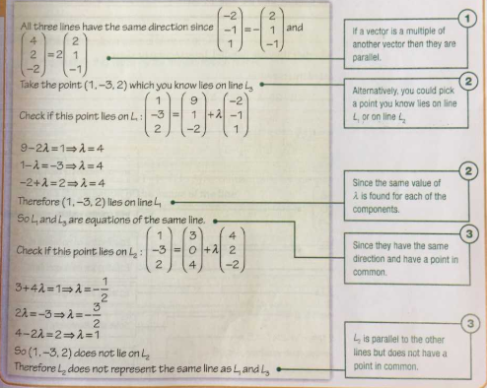
Establish whether or not the point (-5, 5, 6) lies on the line r = $\left(\begin{matrix}3 \\ 1 \\ 0\end{matrix}\right)$ + λ $\left(\begin{matrix}4 \\ −2 \\ −3\end{matrix}\right)$

Slide 7
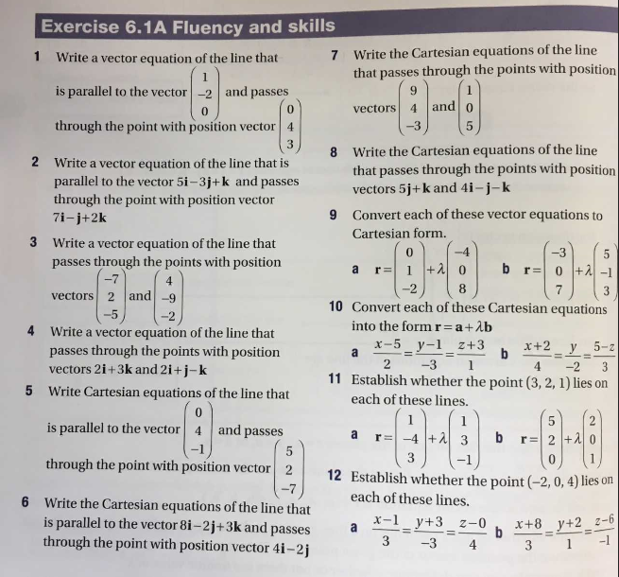
AQA A-Level Further Maths Year 1/AS Level Book
Exercise 6.1A – Page 182

Slide 8
y
y
d
b
c
r
a
r
x
x
The position of a general point on a line may be described in many ways – the vector equation is not unique.
As we can see above we could describe or
We can choose different position vectors and we could choose any parallel vector as our direction vector.
r = a + λb
r = c + λd

Slide 9
Line 1: r = $\left(\begin{matrix}9 \\ 1 \\ −2\end{matrix}\right)$ + λ $\left(\begin{matrix}−2 \\ −1 \\ 1\end{matrix}\right)$
Decide which of these equations represent the same line.
Line 2: r = $\left(\begin{matrix}3 \\ 0 \\ 4\end{matrix}\right)$ + μ $\left(\begin{matrix}4 \\ 2 \\ −2\end{matrix}\right)$
Line 3: $\frac{x−1}{2}$ = $\frac{y+3}{1}$ = $\frac{z−2}{−1}$

Slide 10
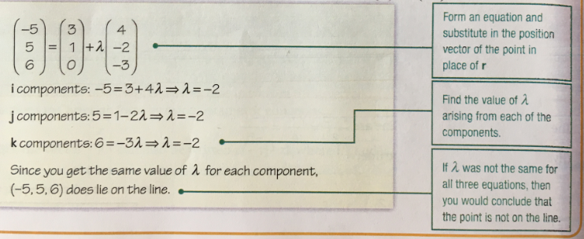
Line 1: r = $\left(\begin{matrix}9 \\ 1 \\ −2\end{matrix}\right)$ + λ $\left(\begin{matrix}−2 \\ −1 \\ 1\end{matrix}\right)$
Decide which of these equations represent the same line.
Line 2: r = $\left(\begin{matrix}3 \\ 0 \\ 4\end{matrix}\right)$ + μ $\left(\begin{matrix}4 \\ 2 \\ −2\end{matrix}\right)$
Line 3: $\frac{x−1}{2}$ = $\frac{y+3}{1}$ = $\frac{z−2}{−1}$

Slide 11
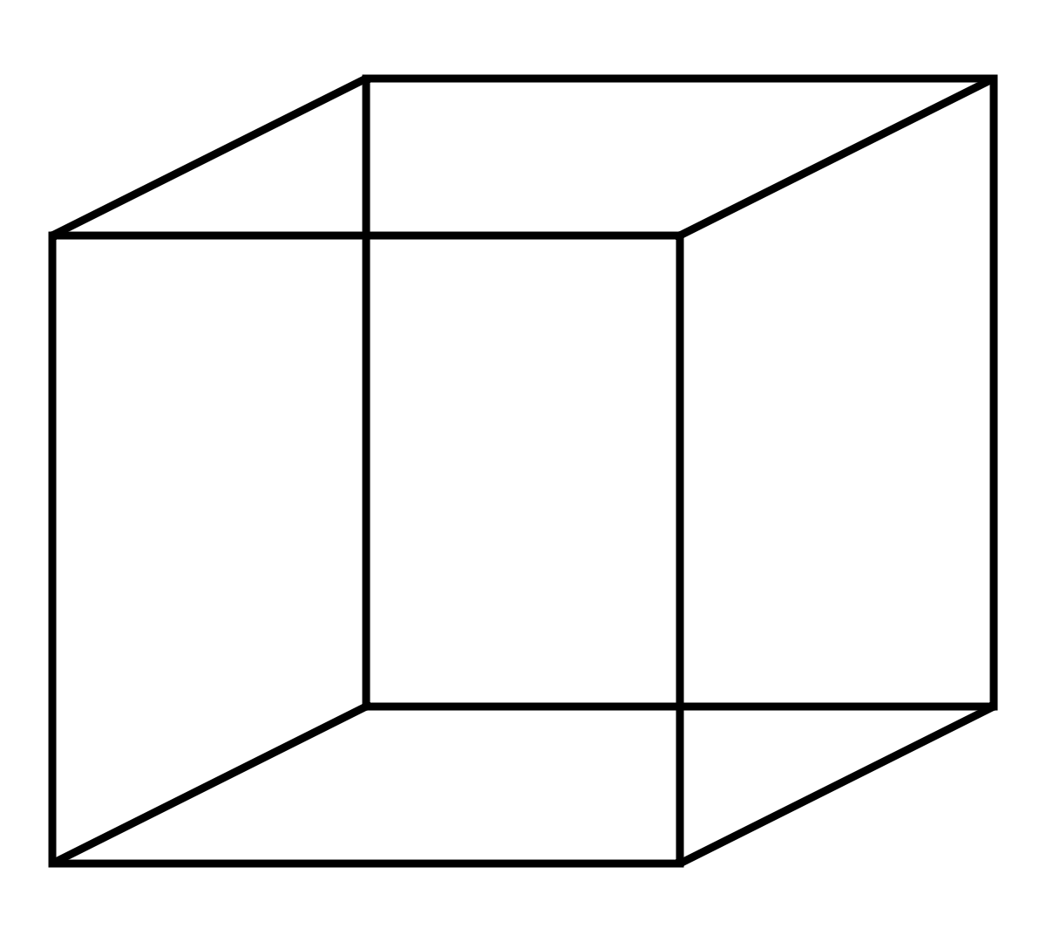
In 2 dimensions, any two lines must be either parallel or they must intersect at some point.
In 3 dimensions, this is not the case any more.
AB & DC are Parallel
AB & AD intersect at Point A
AB & GH are said to skew. They neither intersect or run parallel to each other.
F
G
A
B
E
H
D
C
Two lines are parallel if their direction vectors are scalar multiples of one another.
Two lines intersect if we can simultaneously solve their equations with consistent values throughout.

Slide 12
Decide if these pairs of lines are parallel, intersecting or skew.
If they intersect, find their intersection point.
Line 1: r = 2i – j + λ (3i + j – 2k) Line 2: r = 3i + 2j – k + μ (2i – k)
Line 1: r = $\left(\begin{matrix}1 \\ 0 \\ −8\end{matrix}\right)$ + λ $\left(\begin{matrix}2 \\ −2 \\ −3\end{matrix}\right)$ Line 2: r = $\left(\begin{matrix}−4 \\ 7 \\ −1\end{matrix}\right)$ +μ $\left(\begin{matrix}3 \\ −1 \\ −5\end{matrix}\right)$

Slide 13
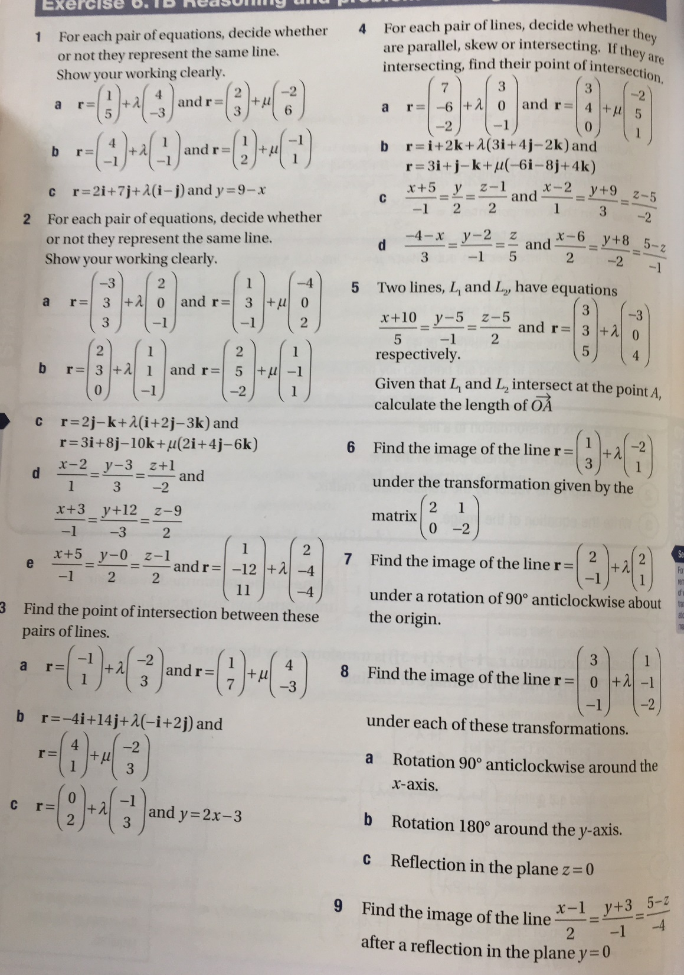
AQA A-Level Further Maths Year 1/AS Level Book
Exercise 6.1B – Page 186

