Slide 1
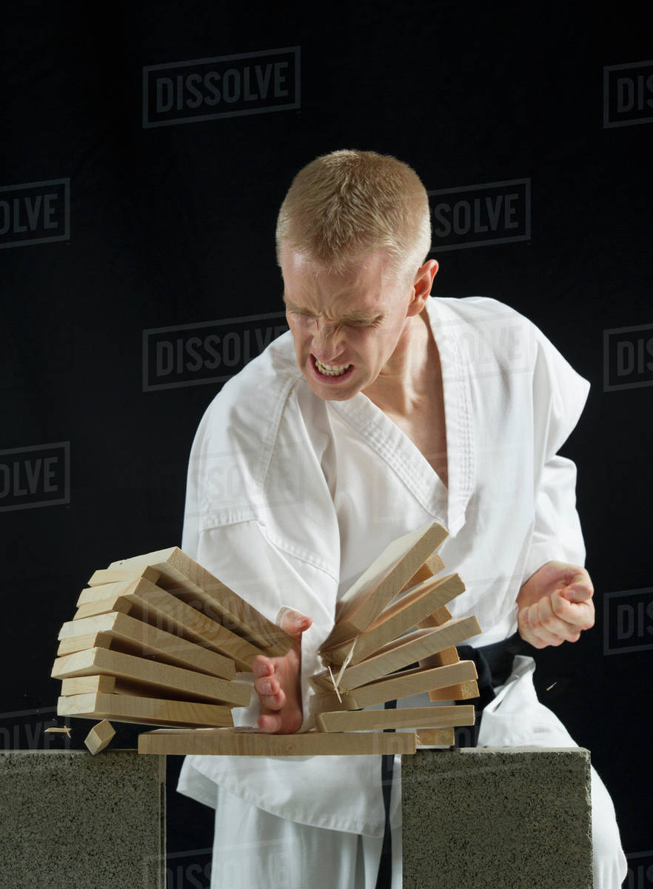
Momentum & Impulse
This karate expert has broken a pile of wooden planks with a single blow from his hand. Forces in excess of 3000N have been measured during karate chops.
Although the karate expert produces a very large force, it acts for only a short time.
When a constant force F acts for a time t the impulse of the force is defined as:
Impulse = force x time
Impulse = F x t
The impulse is a vector in the direction of the force.

Slide 2
Momentum & Impulse
Impulse is often used when force and time cannot be known separately but we know their combined effect.
A tennis player hits a ball of mass 0.06 kg as it is travelling towards her at 10ms⁻¹ horizontally.
Immediately after she hits it, the ball is moving away from her at 20ms⁻¹ horizontally.
We cannot find out the force the player applies to the ball unless we know how long the impact lasts.
Instead we can find the impulse of the tennis racket on the ball.

Slide 3
Momentum & Impulse
When motion is in one dimension and the velocity of an object of mass m is changed from u to v by a constant force F, you can use Newton’s Laws and the equations of motion.
F = ma
v = u + at
→ mv = mu + mat
mv = mu+ Ft
→ Ft = mv – mu
The quantity ‘mass x velocity’ is defined as the momentum of the moving object.
Momentum = m x v
Impulse of Force = Final Momentum – Initial Momentum
Impulse = Change of Momentum

Slide 4
Momentum & Impulse
A tennis player hits a ball of mass 0.06 kg as it is travelling towards her at 10ms⁻¹ horizontally.
Immediately after she hits it, the ball is moving away from her at 20ms⁻¹ horizontally.
Impulse of Force = Final Momentum – Initial Momentum
Ft = mv – mu
This equation holds for any large force acting for a short time, even when the force cannot be assumed to be constant.
The force on the tennis ball will increase as it embeds itself into the strings of the racket and then decrease as it is catapulted away.
We can calculate the impulse on the tennis ball.

Slide 5
Momentum & Impulse
A tennis player hits a ball of mass 0.06 kg as it is travelling towards her at 10ms⁻¹ horizontally.
Immediately after she hits it, the ball is moving away from her at 20ms⁻¹ horizontally.
Impulse of Force = Final Momentum – Initial Momentum
Ft = mv – mu
0.06 x 20 – 0.06 x (-10) = 1.8 Ns
Impulse
Negative due to a change in direction of the ball
Initial momentum
Final momentum

Slide 6
Momentum & Impulse
Bodies A and B with masses m₁ and m₂ and initial velocities u₁ and u₂ collide directly.
During the collision, forces act on the bodies for a short time t.
If the force acting on B is F, then Newton’s 3rd Law states that an equal and opposite force acts on A.
After the collision, A and B separate with velocities v₁ and v₂.
For A: -Ft = m₁ v₁ – m₁ u₁
For B: Ft = m₂ v₂ – m₂ u₂
So: – (m₁ v₁ – m₁ u₁) = m₂ v₂ – m₂ u₂
Rearranging gives: m₁ u₁ + m₂ u₂ = m₁ v₁ + m₂ v₂
Total initial momentum = Total final momentum

Slide 7
Momentum & Impulse
The principle of conservation of linear momentum states that:
“When no external forces are present, the total momentum of a system of particles is unchanged by collisions between them.”
Total initial momentum = Total final momentum

Slide 8
Momentum & Impulse
Three particles A, B and C with masses 1 kg, 4 kg and 12 kg respectively are positioned in a straight line.
Particles B and C are at rest and particle A is moving towards B with a speed of 10 ms⁻¹.
After A and B collide, particle A rebounds backwards and B moves towards C with twice the speed of A.
After B and C collide, they move in opposite directions with the same speed.
Find the final velocities of the particles and show that there are no more collisions between the particles, assuming no other forces act on them.
A 1kg
B 4kg
C 12kg
Initially:
10 ms⁻¹
After 1st Impact:
u ms⁻¹
*
2u ms⁻¹
After 2nd Impact:
u ms⁻¹
v ms⁻¹
*
v ms⁻¹

Slide 9
Momentum & Impulse
A 1kg
B 4kg
C 12kg
Initially:
10 ms⁻¹
After 1st Impact:
u ms⁻¹
*
2u ms⁻¹
After 2nd Impact:
u ms⁻¹
v ms⁻¹
*
v ms⁻¹
When A strikes B: 1 x 10 + 0 = 1 x (-u) + 4 x 2u
7u = 10
$u =1\frac{3}{7}$ ms⁻¹
When B strikes C: 4 x 2u + 0 = 4 x (-v) + 12 x v
8v = 8u
$v=u =1\frac{3}{7}$ ms⁻¹
After these two collisions, A and B are moving in the same direction with the same speed and in the opposite direction to C. Hence there are no further collisions.

Slide 10
Oxford Year 1 A Level Further Maths
Page 238 - Exercise 8.1 A
Page 240 - Exercise 8.1 B

