Slide 1
Momentum - Collisions
Experience tells you that different balls will rebound to different heights.
A tennis ball will bounce higher than a cricket ball.
The surface a ball bounces against will also affect the bounce.
A tennis ball will rebound higher if it is dropped onto a solid concrete floor rather than onto a carpeted floor.
In this lesson, we will look at these situations more closely.

Slide 2
Momentum - Collisions
When two bodies with known masses and velocities collide, their velocities afterwards are unknown.
You need two equations to be able to calculate these two unknowns.
One is the Conservation of Momentum equation:
Total Initial Momentum = Total Final Momentum
The other equation is Newton’s Experimental Law, or Newton’s Law of Impact, which involves the speeds at which the bodies change:
$\frac{Speed of separation}{Speed of approach}=e$
The constant e is the coefficient of restitution. It depends on the elasticity of the bodies and has a value in the range 0 ≤ e ≤ 1.

Slide 3
Momentum - Collisions
$$\frac{Speed of separation}{Speed of approach}=e$$
The constant e is the coefficient of restitution. It depends on the elasticity of the bodies and has a value in the range 0 ≤ e ≤ 1.
e = 0 if the impact is inelastic (that is, there is no rebound)
e = 1 if the impact is perfectly elastic
If the velocities of the objects prior to impact are u₁ and u₂, and the velocities after impact are v₁and v₂, then you can use the equation:
$$e=\frac{v2 −v1}{u2 −u1}$$

Slide 4
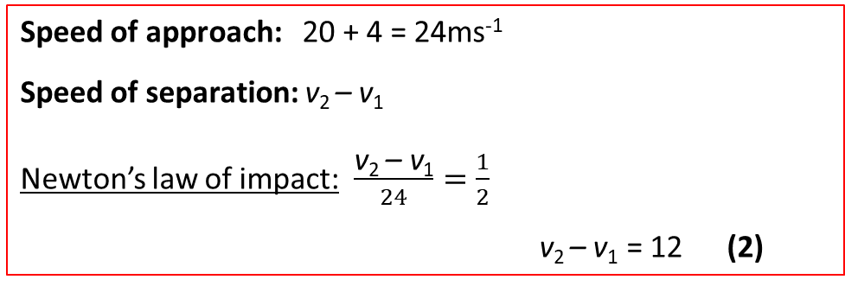
Momentum - Collisions
A particle P with mass 4 kg and velocity 20ms⁻¹ collides directly with particle Q with mass 12 kg travelling with velocity 4ms⁻¹ in the opposite direction.
Given $e=\frac{1}{2}$, calculate the velocities v₁ and v₂ after impact.
P 4kg
Q 12kg
Initially:
20 ms⁻¹
4 ms⁻¹
After Impact:
v₁ ms⁻¹
*
v₂ ms⁻¹
Conservation of momentum: 4 x 20 + 12 x ( –4 ) = 4v₁ + 12v₂
v₁ + 3v₂ = 8 (1)
(1) + (2) gives: 4v₂ = 20 → v₂ = 5
Substituting into (1) gives: v₁ = 8 – 15 = –7
So P moves at 7 ms⁻¹ and Q moves at 5 ms⁻¹ and both change direction after impact.
Speed of approach: 20 + 4 = 24ms⁻¹
Speed of separation: v₂ – v₁
Newton’s law of impact: $\frac{\text{v}\text{2 }\text{– }\text{v}\text{1}}{24}=\frac{1}{2}$
v₂ – v₁ = 12 (2)

Slide 5
Momentum - Collisions
A ball strikes a smooth fixed plane with a velocity of $u=20\sqrt{3}i −20j.$
The coefficient of restitution is e = 0.8
Find the final velocity $v=vxi+vyj$ after impact and the angle θ it makes with the plane.
Before impact:
After impact:
u = $\left(\begin{matrix}ux \\ uy\end{matrix}\right)$
v = $\left(\begin{matrix}vx \\ vy\end{matrix}\right)$
θ
As the plane is smooth, there is no frictional force parallel to the plane and therefore there is no change in the particle’s momentum parallel to the plane. So $ux=vx$
Upon impact, the force upon the ball from the plane acts entirely perpendicular to the plane.
Momentum is not conserved in this direction (because an external force acts), but Newton’s law of impact still applies perpendicular to the plane.
So $e=\frac{vy}{uy}$

Slide 6
Momentum - Collisions
A ball strikes a smooth fixed plane with a velocity of $u=20\sqrt{3}i −20j.$
The coefficient of restitution is e = 0.8
Find the final velocity $v=vxi+vyj$ after impact and the angle θ it makes with the plane.
Before impact:
After impact:
u = $\left(\begin{matrix}ux \\ uy\end{matrix}\right)$
v = $\left(\begin{matrix}vx \\ vy\end{matrix}\right)$
θ
Conservation of momentum along the plane: v_{x} = u_{x} =$20\sqrt{3}$ms⁻¹
Newton’s equation perpendicular to the plane is:
$$\frac{\text{v}\text{y} }{\text{u}\text{y}}=\frac{\text{v}\text{y} }{\text{20}}=0.8$$
v_{y} =$16$ms⁻¹
Final velocity: $v=20\sqrt{3}i+16j \text{ms}\text{−1}$ Angle θ = $\tan^{−1}\left(\frac{\text{v}\text{y} }{\text{v}\text{x}}\right)=\tan^{−1}\left(\frac{\text{16} }{\text{20}√3}\right)=$ 24.8˚

Slide 7
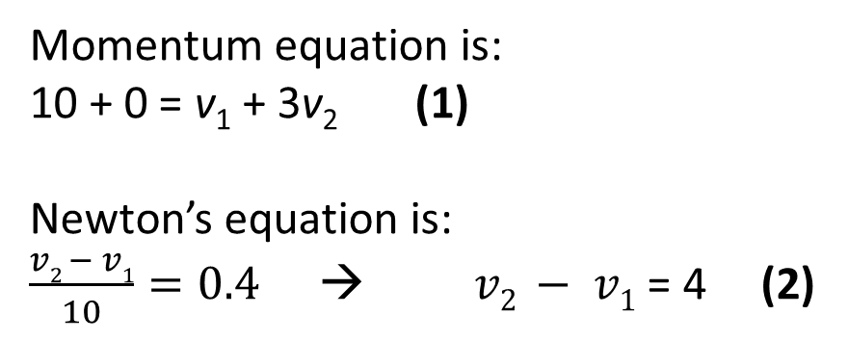
Momentum - Collisions
Two spheres P of mass 1 kg and Q of mass 3 kg lie on a smooth horizontal plane with the line PQ at right angles to a vertical wall. P moves at 10 ms⁻¹ and collides directly with Q, which is initially at rest.
Q then hits the wall and rebounds. If the coefficient of restitution between the spheres is 0.4 and between Q and the wall is e, show that P and Q collide again if e > $\frac{1}{7}$
Before 1st impact:
After 1st impact:
P 1kg
Q 3kg
P 1kg
Q 3kg
10 ms⁻¹
At rest
v₁ ms⁻¹
v₂ ms⁻¹
Momentum equation is:
10 + 0 = v₁ + 3v₂ (1)
Newton’s equation is:
$\frac{v2 − v1}{10}=0.4$ → $v2 − v1$ = 4 (2)
(1) + (2) give v₁ = –0.5 and v₂ = 3.5
P is now moving away from the wall and Q towards the wall.

Slide 8
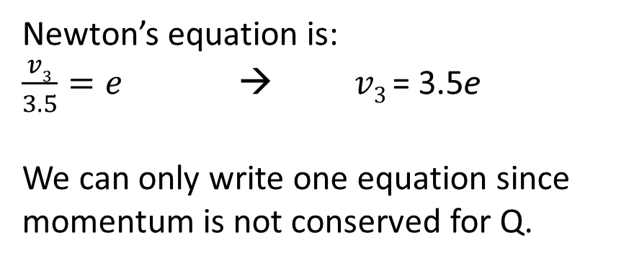
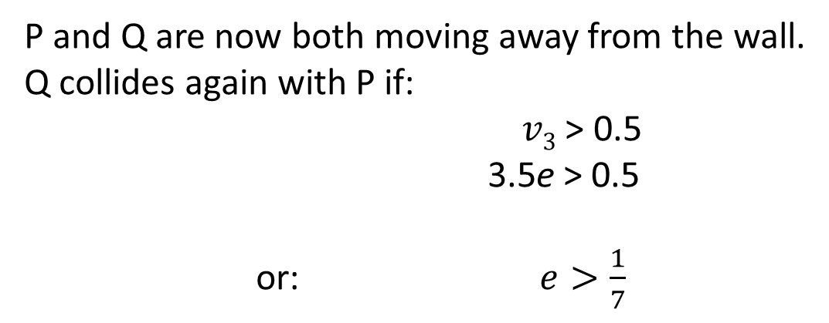
Momentum - Collisions
Two spheres P of mass 1 kg and Q of mass 3 kg lie on a smooth horizontal plane with the line PQ at right angles to a vertical wall. P moves at 10 ms⁻¹ and collides directly with Q, which is initially at rest.
Q then hits the wall and rebounds. If the coefficient of restitution between the spheres is 0.4 and between Q and the wall is e, show that P and Q collide again if e > $\frac{1}{7}$
Before 2nd impact:
After 2nd impact:
P 1kg
Q 3kg
P 1kg
Q 3kg
0.5 ms⁻¹
3.5 ms⁻¹
0.5 ms⁻¹
v₃ ms⁻¹
Newton’s equation is:
$\frac{v3}{3.5}=e$ → $v3$= 3.5e
We can only write one equation since momentum is not conserved for Q.
P and Q are now both moving away from the wall.
Q collides again with P if:
$v3$ > 0.5
3.5e > 0.5
or: $e>\frac{1}{7}$

Slide 9
Oxford Year 1 A Level Further Maths
Page 244 - Exercise 8.2 A
Page 246 - Exercise 8.2 B

