Slide 1
Vectors – Dot (Scalar) Product
Think of the dot product as directional multiplication.
Multiplication goes beyond repeated counting: it's applying the essence of one item to another.
Typical multiplication combines growth rates:
"3 x 4" can mean "Take your 3x growth and make it 4x larger, to get 12x“
If a vector is "growth in a direction", there's a few operations we can do:
Add vectors: Accumulate the growth contained in several vectors.
Multiply by a constant: Make an existing vector stronger.
Dot product: Apply the directional growth of one vector to another. The result is how much stronger we've made the original (positive, negative, or zero).

Slide 2
We will try to understand what this means, and why...
The goal is to apply one vector to another. The equation above shows two ways to accomplish this:
Rectangular perspective: combine x and y components
Polar perspective: combine magnitudes and angles

Slide 3
Seeing Numbers As Vectors
Let's start simple, and treat 3 x 4 as a dot product:
The number 3 is "directional growth" in a single dimension (the x-axis, let's say)
4 is "directional growth" in that same direction.
3 x 4 = 12 means we get 12x growth in a single dimension.

Slide 4
Now, suppose 3 and 4 refer to different dimensions.
Let's say 3 means "triple your bananas" (x-axis)
4 means "quadruple your oranges" (y-axis).
Now they're not the same type of number: what happens when apply growth (use the dot product) in our "bananas, oranges" universe?
(3,0) means "Triple your bananas, destroy your oranges"
(0,4) means "Destroy your bananas, quadruple your oranges"

Slide 5
Applying (0,4) to (3,0) means
"Destroy your banana growth, quadruple your orange growth".
But (3, 0) had no orange growth to begin with, so the net result is 0
See how we're "applying" and not simply adding?
With regular addition, we smush the vectors together:
(3,0) + (0, 4) = (3, 4)
[a vector which triples your oranges and quadruples your bananas].

Slide 6
"Application" is different.
We're mutating the original vector based on the rules of the second.
The rules of (0, 4) are
"Destroy your banana growth, and quadruple your orange growth."
When applied to something with only bananas, like (3, 0), we're left with nothing.

Slide 7
The final result of the dot product process can be:
Zero: we don't have any growth in the original direction
Positive number: we have some growth in the original direction
Negative number: we have negative (reverse) growth in the original direction

Slide 8
Understanding The Calculation
"Applying vectors" is still a bit abstract.
You can think "How much energy/push is one vector giving to the other?".

Slide 9
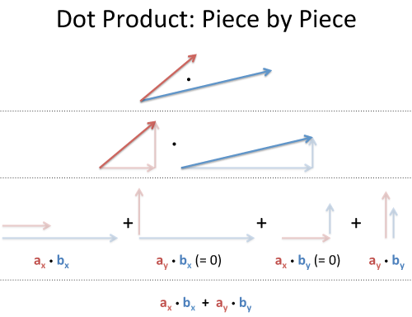
Rectangular Coordinates: Component-by-component overlap
Like multiplying complex numbers, see how each x- and y-component interacts:

Slide 10
We list out all four combinations (x with x, y with x, x with y, y with y).
Since the x- and y-coordinates don't affect each other
(like holding a bucket sideways under a waterfall -- nothing falls in)

Slide 11
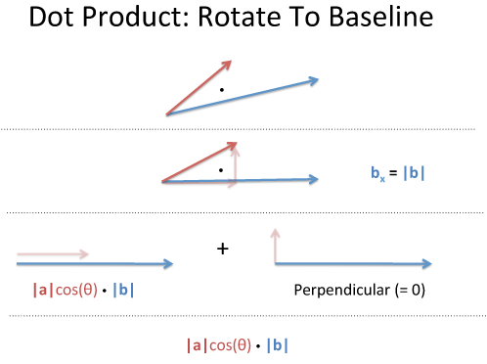
Polar coordinates: Projection
The word "projection" is so sterile: I prefer "along the path".
How much energy is actually going in our original direction?

Slide 12
Take two vectors, a and b.
Rotate our coordinates so b is horizontal: it becomes (|b|, 0), and everything is on this new x-axis.
What's the dot product now? (It shouldn't change just because we tilted our head).
Well, vector a has new coordinates (a1, a2), and we get:
a1 is really "What is the x-coordinate of a, assuming b is the x-axis?".
That is |a|cos(θ), aka the "projection":

Slide 13
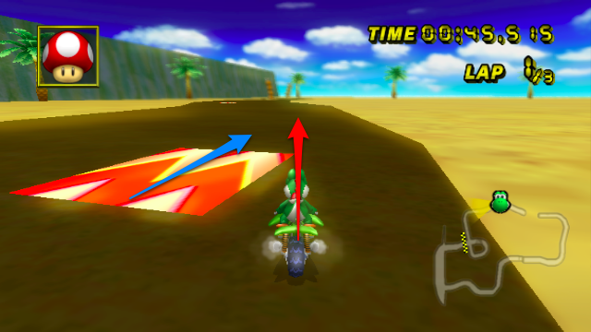
Mario-Kart Speed Boost
In Mario Kart, there are "boost pads" on the ground that increase your speed
Imagine the red vector is your speed (x and y direction), and the blue vector is the orientation of the boost pad (x and y direction).
Larger numbers are more power.

Slide 14
How much boost will you get? For the analogy, imagine the pad multiplies your speed:
If you come in going 0, you'll get nothing [if you are just dropped onto the pad, there's no boost]
If you cross the pad perpendicularly, you'll get 0 [just like the banana obliteration, it will give you 0x boost in the perpendicular direction]

Slide 15
But, if we have some overlap, our x-speed will get an x-boost, and our
y-speed gets a y-boost:
Another way to see it: your incoming speed is |a|, and the max boost is |b|. The amount of boost you actually get (for being lined up with it) is cos(θ), for the total: |a|.|b| cos (θ)

