Slide 1
Vectors – Finding Distances
r = a + λb
What would the shortest line between point C and the line look like?
C
What do we know about perpendicular lines from previous lessons?
The Dot Product (scalar product) will equal zero.

Slide 2
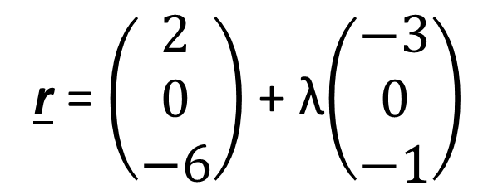
Vectors – Finding Distances
r = $\left(\begin{matrix}2 \\ 0 \\ −6\end{matrix}\right)$ + λ$\left(\begin{matrix}−3 \\ 0 \\ −1\end{matrix}\right)$
Find the shortest distance from C to the line r.
1. Find a vector that passes through the point and the line.
C = (3, 3, 1)
Look at the difference between the coordinates of C and the coordinates of a general point on r.
$$\left(\begin{matrix}2 \\ 0 \\ −6\end{matrix}\right) − \left[\left(\begin{matrix}2 \\ 0 \\ −6\end{matrix}\right)\text{ + }\text{λ}\left(\begin{matrix}−3 \\ 0 \\ −1\end{matrix}\right)\right]=\left(\begin{matrix}1+3\text{λ} \\ 3 \\ 7+\text{λ}\end{matrix}\right)$$

Slide 3
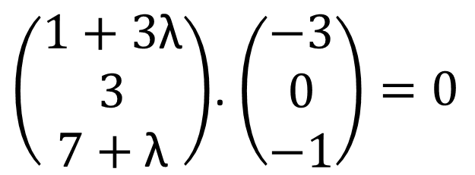
Vectors – Finding Distances
r = $\left(\begin{matrix}2 \\ 0 \\ −6\end{matrix}\right)$ + λ$\left(\begin{matrix}−3 \\ 0 \\ −1\end{matrix}\right)$
Find the shortest distance from C to the line r.
2. Since this vector and the original line are perpendicular, their dot product = 0
C = (3, 3, 1)
$\left(\begin{matrix}1+3\text{λ} \\ 3 \\ 7+\text{λ}\end{matrix}\right)$. $\left(\begin{matrix}−3 \\ 0 \\ −1\end{matrix}\right)=0$
$$−3−9\text{λ}−7−\text{λ}=0$$
$$\text{λ}=−1$$

Slide 4
Vectors – Finding Distances
r = $\left(\begin{matrix}2 \\ 0 \\ −6\end{matrix}\right)$ + λ$\left(\begin{matrix}−3 \\ 0 \\ −1\end{matrix}\right)$
(5, 0, -5)
Find the shortest distance from C to the line r.
3. Substitute the value of $\text{λ}$ into the equation of the line, to find the point of intersection of the line with the perpendicular through (3, 3, 1).
C = (3, 3, 1)
$$\left(\begin{matrix}2 \\ 0 \\ −6\end{matrix}\right)−1\left(\begin{matrix}−3 \\ 0 \\ −1\end{matrix}\right)=\left(\begin{matrix}5 \\ 0 \\ −5\end{matrix}\right)$$

Slide 5
Vectors – Finding Distances
r = $\left(\begin{matrix}2 \\ 0 \\ −6\end{matrix}\right)$ + λ$\left(\begin{matrix}−3 \\ 0 \\ −1\end{matrix}\right)$
(5, 0, -5)
Find the shortest distance from C to the line r.
4. Find the distance from point C at (3, 3, 1) to the point of intersection at (5, 0, -5)
C = (3, 3, 1)
$$Distance= \sqrt{{(5−3)}^{2}+{(0−3)}^{2}+{(−5−1)}^{2}}$$
$$Distance=7$$

Slide 6
Vectors – Finding Distances
r = a + λb
r = c + μb
If two lines do not intersect then we have two cases to consider: the lines are parallel or they are skew.
If two lines are parallel, since their separation is the same all the way along the line, we can choose any point on either line and use the previous method to find the distance from the point to the other line.

Slide 7
Vectors – Finding Distances
r = a + λb
P
r = c + μb
If two lines are skew, there will be particular points on each line which gives the minimum distance.
What can we say about the vector between these points?
Q

Slide 8
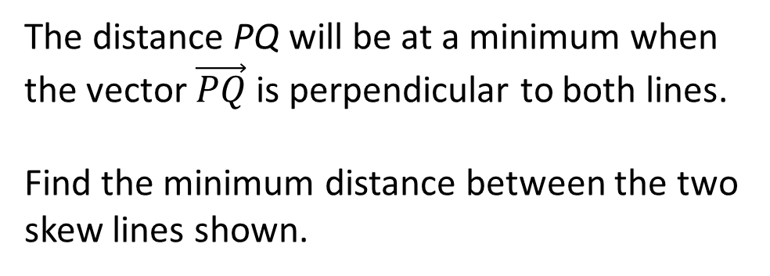
Vectors – Finding Distances
Line L₁: r = 2i + j + λ(–j + 2k)
P
Line L₂: r = j – 2k + μ(i + 2j)
Q
The distance PQ will be at a minimum when the vector $\vec{PQ}$ is perpendicular to both lines.
Find the minimum distance between the two skew lines shown.

Slide 9
Vectors – Finding Distances
L₁ = 2i + j + λ(–j + 2k)
1. Identify a vector between these two general points
P
L₂ = j – 2k + μ(i + 2j)
A general point, P, on the first line has position vector $\vec{OP}=\left(\begin{matrix}2 \\ 1−λ \\ 2λ\end{matrix}\right)$
Q
A general point, Q, on the second line line has position vector $\vec{OQ}=\left(\begin{matrix}μ \\ 1+2μ \\ −2\end{matrix}\right)$
The vector $\vec{PQ}=\left(\begin{matrix}μ \\ 1+2μ \\ −2\end{matrix}\right)−\left(\begin{matrix}2 \\ 1−λ \\ 2λ\end{matrix}\right)=\left(\begin{matrix}μ−2 \\ 2μ+λ \\ −2−2λ\end{matrix}\right)$

Slide 10
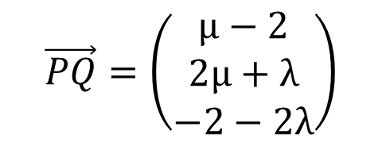
Vectors – Finding Distances
L₁ = 2i + j + λ(–j + 2k)
$$\vec{PQ}=\left(\begin{matrix}μ−2 \\ 2μ+λ \\ −2−2λ\end{matrix}\right)$$
2. Find the dot product between each line and this vector and equate to 0.
P
L₂ = j – 2k + μ(i + 2j)
Since $\vec{PQ}$ is perpendicular to Line L₁: $\left(\begin{matrix}μ−2 \\ 2μ+λ \\ −2−2λ\end{matrix}\right).\left(\begin{matrix}0 \\ −1 \\ 2\end{matrix}\right)=0$
Q
Since $\vec{PQ}$ is perpendicular to Line L₂: $\left(\begin{matrix}μ−2 \\ 2μ+λ \\ −2−2λ\end{matrix}\right).\left(\begin{matrix}0 \\ −1 \\ 2\end{matrix}\right)=0$

Slide 11
Vectors – Finding Distances
L₁ = 2i + j + λ(–j + 2k)
$$\vec{PQ}=\left(\begin{matrix}μ−2 \\ 2μ+λ \\ −2−2λ\end{matrix}\right)$$
P
L₂ = j – 2k + μ(i + 2j)
Q
$\left(\begin{matrix}μ−2 \\ 2μ+λ \\ −2−2λ\end{matrix}\right).\left(\begin{matrix}0 \\ −1 \\ 2\end{matrix}\right)=0 → −\left(2μ+ λ\right)+2\left(−2−2λ\right)=0$ $→ −2μ−5λ=4$
$$\left(\begin{matrix}μ−2 \\ 2μ+λ \\ −2−2λ\end{matrix}\right).\left(\begin{matrix}1 \\ 2 \\ 0\end{matrix}\right)=0 → \left(μ−2\right)+2\left(2μ+λ\right)=0 → 5μ+2λ=2$$

Slide 12


Vectors – Finding Distances
L₁ = 2i + j + λ(–j + 2k)
$$\vec{PQ}=\left(\begin{matrix}μ−2 \\ 2μ+λ \\ −2−2λ\end{matrix}\right)$$
P
3. Solve the simultaneous equations
L₂ = j – 2k + μ(i + 2j)
Q
$$−2μ−5λ=4$$
$$5μ+2λ=2$$
$$μ=\frac{6}{7} λ=−\frac{8}{7}$$

Slide 13
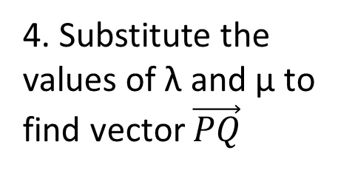
Vectors – Finding Distances
L₁ = 2i + j + λ(–j + 2k)
4. Substitute the values of λ and μ to find vector $\vec{PQ}$
P
L₂ = j – 2k + μ(i + 2j)
$\vec{PQ}=\left(\begin{matrix}μ−2 \\ 2μ+λ \\ −2−2λ\end{matrix}\right) μ=\frac{6}{7} λ=−\frac{8}{7}$
Q
$\vec{PQ}=\left(\begin{matrix}μ−2 \\ 2μ+λ \\ −2−2λ\end{matrix}\right)=\left(\begin{matrix}−\frac{8}{7} \\ \frac{4}{7} \\ \frac{2}{7}\end{matrix}\right)$

Slide 14
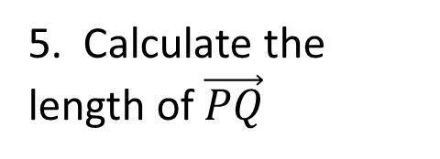
Vectors – Finding Distances
L₁ = 2i + j + λ(–j + 2k)
5. Calculate the length of $\vec{PQ}$
P
L₂ = j – 2k + μ(i + 2j)
Q
Distance PQ = $\sqrt{{\left(−\frac{8}{7}\right)}^{2}+{\left(\frac{4}{7}\right)}^{2}+{\left(\frac{2}{7}\right)}^{2}}$
$\vec{PQ}=\left(\begin{matrix}−\frac{8}{7} \\ \frac{4}{7} \\ \frac{2}{7}\end{matrix}\right)$
Distance PQ = $\frac{2\sqrt{21}}{7}=1.31$ to 3 sig. fig.

Slide 15
Vectors – Finding Distances
We can use the perpendicular vector to find the reflection of a point in a line.
When a point A is reflected in a line to give the image A’, then the line will be the perpendicular bisector of the line segment AA’.
You can use this fact to find the coordinates of A’
A
M
A’
Write the vector $\vec{AM}$
Use the fact that $\vec{AM}$ is perpendicular to the mirror line so the scalar product of $\vec{AM}$ with the direction vector of the line is zero.
Use the fact that $\vec{AA′}=2\vec{AM}$ to find the position of A’

