Slide 1
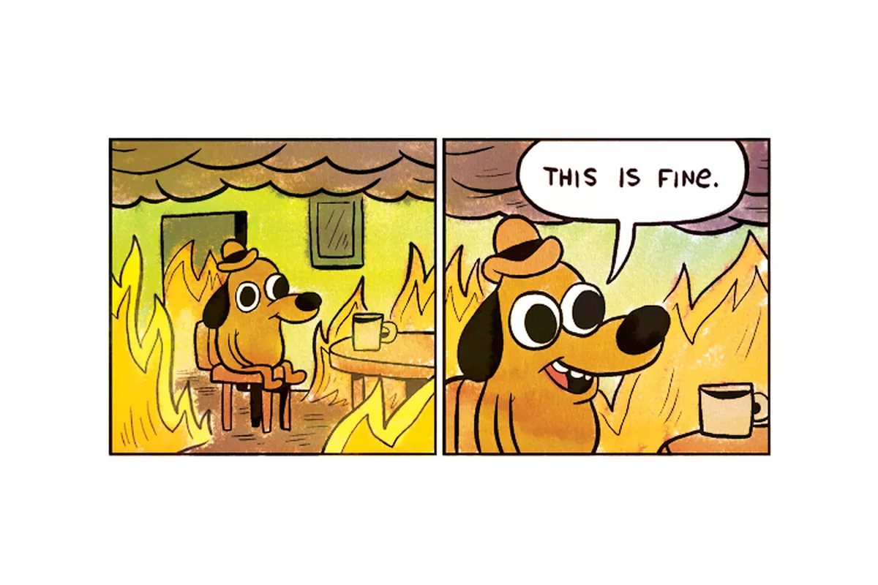
What are your two least favourite topics in discrete?
Game theory?
Simplex?
How about we combine them both into Fran’s personal hell!

Slide 2
Game Theory to Linear Programming
Fluency: Recall how to solve a game theory problem
Key Words
Maximin
Minimax
Optimal
Dominance
Reasoning: Implement Simplex method to solve game theory problem
Problem Solving: Improve upon the method by reducing the number of variables if possible

Slide 3
Knowledge Check Fluency
What is the play safe strategy?
What is a stable solution?
Maximise the minimum or rows (Maximin) then minimise the maximum of columns (Minimax)
Stable if Maximin=Minimax

Slide 4
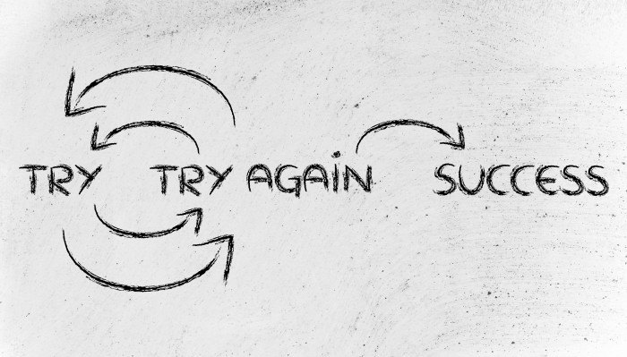
A reminder of Game Theory Fluency
Express the value of the game below.
 | $$B_{1}$$ | $$B_{2}$$
$$A_{1}$$ | -3 | 5
$$A_{2}$$ | 3 | -1

Slide 5
A reminder of Game Theory Fluency
 | $$B_{1}$$ | $$B_{2}$$ | MIN
$$A_{1}$$ | -3 | 5 | -3
$$A_{2}$$ | 3 | -1 | -1
MAX | 3 | 5
Minimax and maximin are -1 and 3, so there is not a stable solution. If they always play safe then A will win 3. The value of the game would be 3.
They need to apply a mixed strategy.

Slide 6
A reminder of Game Theory Fluency
 | $$B_{1}$$ | $$B_{2}$$ | MIN
$$A_{1}$$ | -3 | 5 | -3
$$A_{2}$$ | 3 | -1 | -1
MAX | 3 | 5
If B plays $B_{1}$ then the expected pay off is
$$−3p+3\left(1−p\right)=3−6p$$
If B plays $B_{2}$ then the expected pay off is
$$5p+\left(−1\right)\left(1−p\right)=6p−1$$
The value of the game cannot be greater than these so we create two inequalities which would then be solved graphically
$v≤3−6p$ and $v≤6p−1$

Slide 7
Fully Worked Example Reasoning
Use the simplex method to solve this zero-sum game to find the optimal strategy for player A and the value of the game.
 | $$B_{1}$$ | $$B_{2}$$
$$A_{1}$$ | 1 | -2
$$A_{2}$$ | 0 | -1
$$A_{3}$$ | -1 | 0
If there are only two strategies involved, you can solve graphically. If there are more than two, you must use simplex

Slide 8
 | $$B_{1}$$ | $$B_{2}$$
$$A_{1}$$ | 1 | -2
$$A_{2}$$ | 0 | -1
$$A_{3}$$ | -1 | 0
For simplex to work, you must make all values non negative. Remember that whatever you add to all values, you must subtract from the value of your game at the end. In this instance, we will add 2.
 | $$B_{1}$$ | $$B_{2}$$
$$A_{1}$$ | 3 | 0
$$A_{2}$$ | 2 | 1
$$A_{3}$$ | 1 | 2

Slide 9
 | $$B_{1}$$ | $$B_{2}$$
$$A_{1}$$ | 3 | 0
$$A_{2}$$ | 2 | 1
$$A_{3}$$ | 1 | 2
Our aim is to maximise P=V (profit=value)
$$v≤3p_{1}+2p_{2}+p_{3}$$
$$v≤p_{2}+2p_{3}$$
$$p_{1}+p_{2}+p_{3}≤1$$
$$p_{1},p_{2},p_{3},v≥0$$
So we have three inequalities and the equation to rearrange into simplex equations. Don’t forget to add slack variables where necessary.

Slide 10
$$P−v=0$$
$$v−3p_{1}−2p_{2}−p_{3}+s=0$$
$$v−p_{2}−2p_{3}+t=0$$
$$p_{1}+p_{2}+p_{3}+u=1$$
You could complete simplex with these values but to be more efficient we will eliminate $p_{3}$ using substitution $p_{3}=1−p_{1}−p_{2}$
$$P−v=0$$
$$v−3p_{1}−2p_{2}−\left(1−p_{1}−p_{2}\right)+s=v−2p_{1}−p_{2}+s=0$$
$$v−p_{2}−2\left(1−p_{1}−p_{2}\right)+t=v+2p_{1}+p_{2}+t=2$$
Create and solve a simplex tableaux for the highlighted equations

Slide 11
P | v | $$p_{1}$$ | $$p_{2}$$ | s | t | Value | Label
1 | -1 | 0 | 0 | 0 | 0 | 0 | $$R_{1}$$
0 | 1 | -2 | -1 | 1 | 0 | 1 | $$R_{2}$$
0 | 1 | 2 | 1 | 0 | 1 | 2 | $$R_{3}$$
P | v | $$p_{1}$$ | $$p_{2}$$ | s | t | Value | Label
1 | 0 | -2 | -1 | 1 | 0 | 1 | $$R_{4}=R_{1}+R_{2}$$
0 | 1 | -2 | -1 | 1 | 0 | 1 | $$R_{5}=R_{2}$$
0 | 0 | 4 | 2 | -1 | 1 | 1 | $$R_{6}=R_{3}−R_{2}$$
P | v | $$p_{1}$$ | $$p_{2}$$ | s | t | Value | Label
1 | 0 | 0 | 0 | $$1/2$$ | $$1/2$$ | $$3/2$$ | $$R_{7}=R_{4}+{2R}_{9}$$
0 | 1 | 0 | 0 | $$1/2$$ | $$1/2$$ | $$3/2$$ | $$R_{8}=R_{5}+{2R}_{9}$$
0 | 0 | 1 | $$1/2$$ | $${−1}/4$$ | $$1/4$$ | $$1/4$$ | $$R_{9}={R_{6}}/4$$

Slide 12
P | v | $$p_{1}$$ | $$p_{2}$$ | s | t | Value | Label
1 | 0 | 0 | 0 | $$1/2$$ | $$1/2$$ | $$3/2$$ | $$R_{7}=R_{4}+{2R}_{9}$$
0 | 1 | 0 | 0 | $$1/2$$ | $$1/2$$ | $$3/2$$ | $$R_{8}=R_{5}+{2R}_{9}$$
0 | 0 | 1 | $$1/2$$ | $${−1}/4$$ | $$1/4$$ | $$1/4$$ | $$R_{9}={R_{6}}/4$$
From this table then $V=1.5$, but we must remember that we added 2 to all values initially to make them non zero.
Hence $V=−0.5, p_{1}=0.25, p_{2}=0$ then $p_{3}=0.75$

Slide 13
Strategy
If necessary construct a pay off matrix
Use domination to reduce the table
Check it doesn’t have a stable solution
Write as a linear programming problem
Turn into equations with slack variables
Apply simplex until objective row is non negative
Use the table to get the value of the probabilities and game value
Make sure you answer the question!

Slide 14
Now you try! Problem Solving
Show that this zero-sum game requires a mixed strategy, find A’s best strategy and the value of the game.
 | $$B_{1}$$ | $$B_{2}$$ | $$B_{3}$$
$$A_{1}$$ | 0 | -1 | -1
$$A_{2}$$ | -1 | 0 | 1
$$A_{3}$$ | -2 | 1 | 2
HINT: Do any columns dominate?

Slide 15
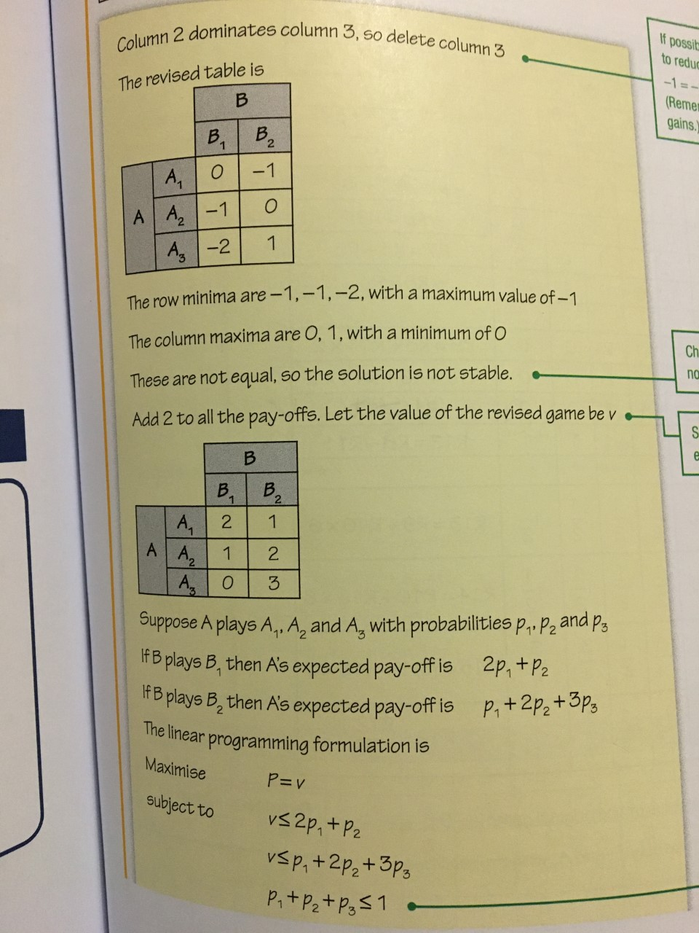
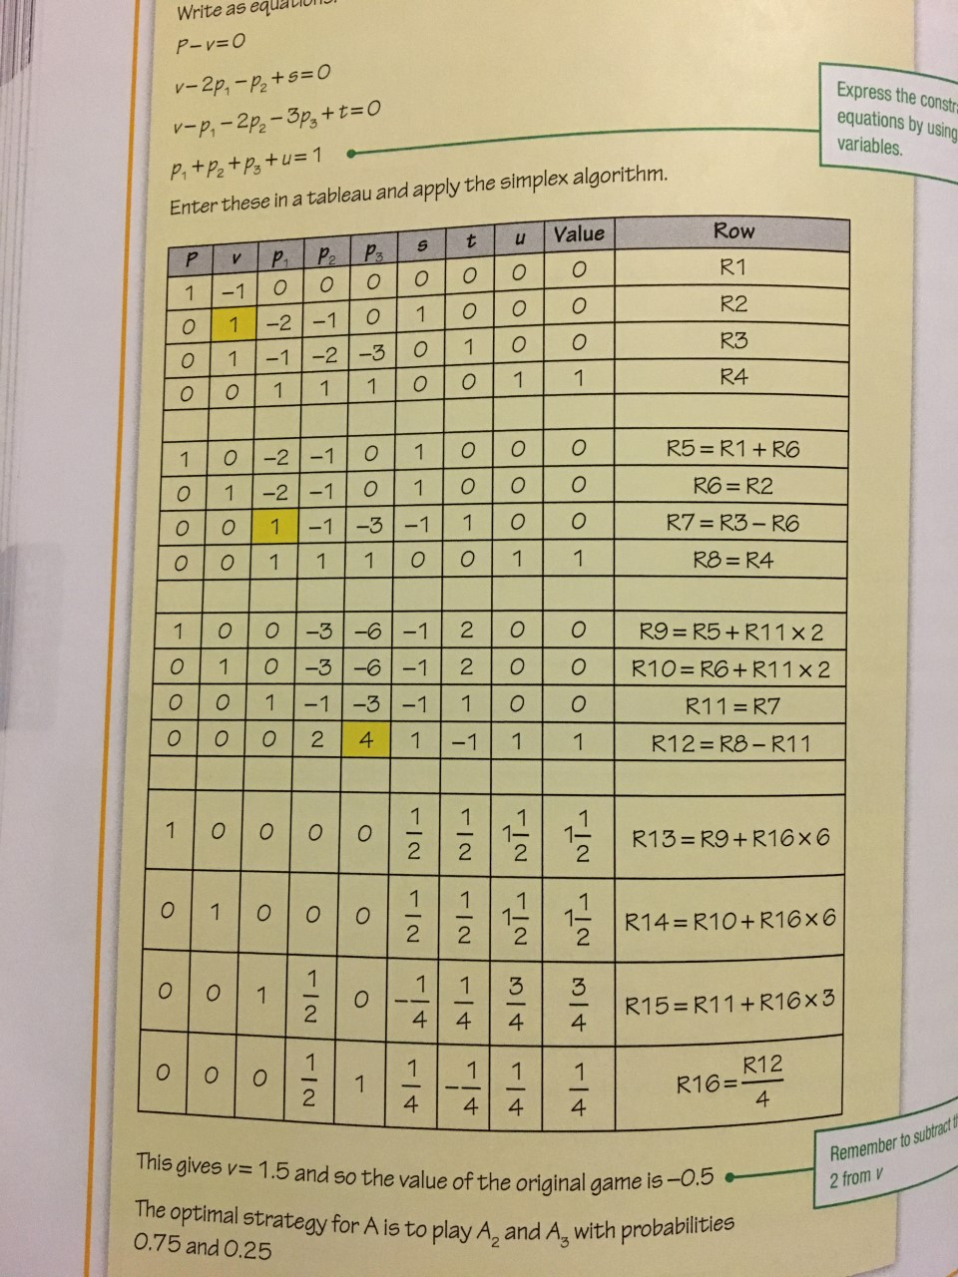
Now you try! Fluency

Slide 16
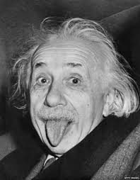
Challenge
An entertainment company plans to run nine outdoor events in different localities on the same day. If the weather at a given locality is fine they expect to make £1200, if it rains, they will lose £400.
They could take out insurance policies. The basic policy costs £500 and pays £1300 if it rains. The comprehensive policy costs £800 and pays £2400 if it rains.
Their strategies are $A_{1}$ no insurance, $A_{2}$ basic, $A_{3}$ comprehensive. Analyse this as a game against the weather (rain or no rain are the strategies) and advise the company on the best approach.
What assumptions have you based your advice on?

Slide 17
Challenge Answers
 | Rain | No Rain
$$A_{1}$$ | -4 | 12
$$A_{2}$$ | 4 | 7
$$A_{3}$$ | 12 | 4
Pay off matrix is given in 100s.
Don’t forget it if it rains you still have the cost of the policy and the £400 lost
a)
Add 4 to all entries to make it non negative
$$P−v=0$$
$$v−8p_{2}−16p_{3}+s=0$$
$$v−16p_{1}−11p_{2}−8p_{3}+t=0$$
$$p_{1}+{p_{2}+p}_{3}+u=1$$
Value is $10\frac{2}{3}−4=6\frac{2}{3}$ when $p_{1}=\frac{1}{3}$, $p_{2}=0$, $p_{3}=\frac{2}{3}$
They should not use basic insurance and should randomly choose comprehensive for $\frac{2}{3}$ of the 9 events.

Slide 18
Challenge Answers
They would expect to make $9×6\frac{2}{3}×100=£6000$
As there are 9 events, value is $6\frac{2}{3}$ and our table was in the 100s of pounds.
b) You are assuming that the weather is independent at every location and also that there is an equal probability of rain at each location.

Slide 19
Plenary – Rank your confidence
Recall stable solutions
Use dominance to reduce game theory tables
Convert linear programming problems to simplex
Apply simplex to game theory

Slide 20
Homework
Chapter 6.5

