Slide 1
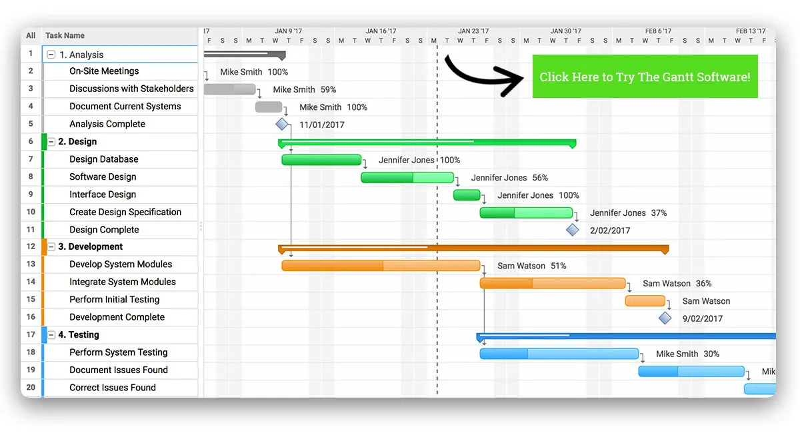

Slide 2
Gantt Charts and
Resource Histograms
Key Words
Fluency: Recall key elements of a critical path
Precedence
Heuristic
Levelling
Cascade
Float
Reasoning: Utilise a Gantt Chart and Resource Histograms to display activities
Problem Solving: Improve a resource histogram by using resource levelling
Define the key words

Slide 3
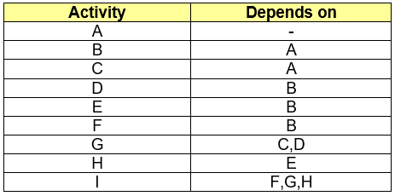
Knowledge Check Fluency
Draw an activity network for the following information

Slide 4
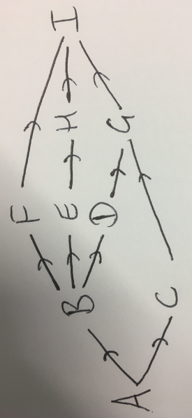
Knowledge Check - ANSWERS Fluency

Slide 5
Knowledge Check 2 Fluency
Draw an activity network, complete the table and identify the critical path
Activity | Duration | Immediate Predecessor | Float
A | 2 | -
B | 3 | -
C | 4 | A,B
D | 2 | B
E | 4 | C
F | 2 | C,D

Slide 6
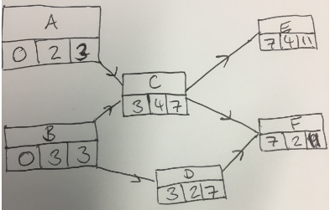
Knowledge Check 2 Fluency
Critical path is BCE

Slide 7
Knowledge Check - ANSWERS Fluency
Activity | Duration | Immediate Predecessor | Float
A | 2 | - | 1
B | 3 | - | 0
C | 4 | A,B | 0
D | 2 | B | 2
E | 4 | C | 0
F | 2 | C,D | 2

Slide 8
Gantt Charts Reasoning
Gantt charts are also called Cascade charts.
You draw activities against a time scale
The bars are solid for the length of the activity
If there is a float, this is added at the end but not shaded in
Critical activities are therefore only a solid bar

Slide 9
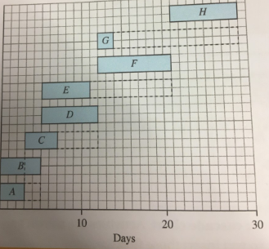
Gantt Charts Reasoning
Duration
Float
You can draw the critical activities along the bottom and touching to create a critical path

Slide 10
Resource Histograms Reasoning
A resource histogram helps to display the number of workers on activities at any given moment
You must remember if activities have others that must occur first
The height of the bar is the number of workers and the length is the duration

Slide 11
Complete the constructing a network activity
Challenge: What would you do if you only had 4 workers available to employ at any given time?
Practice: Move onto question one of the exam questions

Slide 12
Resource Levelling Problem Solving
Resource levelling is employing a heuristic approach (you simply try to find the optimal solution through observation)
Consider the floats if you are asked to keep the project within the minimum time
If a limit is placed on the number of workers then the duration of the project is likely to increase

Slide 13
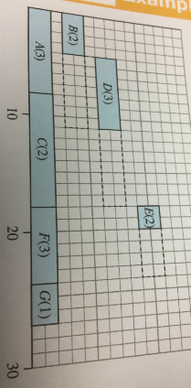
The values in brackets represent the number of workers required for each activity
Draw a resource histogram assuming that each activity starts as soon as possible.
How many workers are needed?

Slide 14
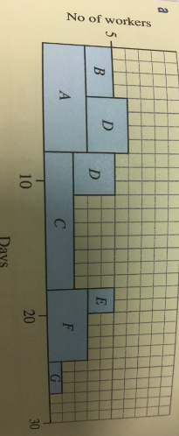
Resource Levelling Problem Solving
The project requires 6 workers

Slide 15
Resource Levelling Problem Solving
You can delay D, so the project can be completed by 5 workers

Slide 16
Resource Levelling Problem Solving
The only activities that could be carried out simultaneously with 4 workers are B and C so the activity would now take 36 days, which is an extension of 9 days.
Now complete question 2 of the exam questions

Slide 17
Plenary – State your confidence with each skill
Calculate the earliest and latest start and finish times for an activity network
Draw a Gantt chart for a project
Draw a resource histogram with every activity starting as early as possible
Use resource levelling to reschedule activities to minimise the number of workers needed
Use resource levelling to reschedule a project with extended duration when the number of workers is limited
What will you do to improve?

Slide 18
Homework
Complete Chapter 4.3 questions and self assess

