Slide 1
X

Slide 2
Simplex Algorithm
Key Words
Fluency: Summarise inequalities into a simplex tableau
Variables
Slack
Feasible
Optimal
Pivot
Reasoning: Carry out the simplex algorithm using elimination method
Problem Solving: Verify that you have an optimal solution
Define the key words

Slide 3
Knowledge Check Fluency
A paper recycler has two processing plants.
Plant A can process 4 tonnes of waste paper and 1 tonne of cardboard per hour.
Plant B can process 5 tonnes of waste paper and 2 tonnes of cardboard per hour.
It costs £400 per hour to run plant A and £600 per hour to run plant B.
There is a union agreement that each plant must get at least one third of the run time of every consignment.
A consignment of 100 tonnes of waste paper and 35 tonnes of cardboard must be shared between the plants so that costs are minimised.
Write this as a linear programming formulation.

Slide 4
Knowledge Check - ANSWERS Fluency
 | Waste paper | Cardboard | Cost
Plant A (1 hour) | 4 | 1 | 400
Plant B (1 hour) | 5 | 2 | 600
Availability | 100 | 35
Let x be hours for plant A and y be hours for plant B
$x≥\frac{1}{3}(x+y)$ and $y≥\frac{1}{3}(x+y)$
Simplified become $y≤2x$ and $x≤2y$
$$4x+5y≥100$$
$$x+2y≥35$$
$$C=400x+600y$$
$x≥0$ and $y≥0$

Slide 5
Simplex Algorithm Reasoning
This is an algebraic method used to solve linear programming problems where there are three or more decision variables

Slide 6
The simplex algorithm
● Formulate the problem as a tableau
● Ensure that all elements in the last column
(except possibly the top one) are non-negative
● Identify smallest value in top row to obtain pivot column
● Calculate θ = ‘value’ ÷ ‘pivot column’ for each row (except top row)
● Identify smallest non-negative θ to obtain pivot (the number in the pivot column)
● Divide row identified by pivot to obtain pivot row, shown in new table
● Combine appropriate multiples of all other rows with the pivot row in order to make all other elements in the pivot column zero
● If all values in the top row are non-negative, an optimal solution has been found. If not, repeat steps above.

Slide 7
Consider this linear programming problem:
Maximise
Subject to:
This cannot be represented by a graph as there are 3 variables
We solve problems like this using the Simplex Algorithm, created in 1947.
It has become an invaluable, contemporary tool in microeconomics, company management and operational research, all of which are concerned with making decisions about how to allocate limited resources.

Slide 8
As inequalities
As equations
And P = 35x + 55y + 60z can be re-written as:
P – 35x – 55y – 60z = 0
These equations then need putting into a tableau:
P | x | y | z | r | s | t | Value
1
-35
-55
-60
0
0
0
0
0
7
10
10
1
0
0
3600
0
6
9
12
0
1
0
3600
0
2
3
4
0
0
1
2400

Slide 9
Simplex Algorithm Reasoning
Complete the simplex practice sheet

Slide 10
P | x | y | z | r | s | t | Value
θ
R₁
1
-35
-55
-60
0
0
0
0
R₂
0
7
10
10
1
0
0
3600
360
R₃
0
9
12
1
300
6
12
0
0
3600
R₄
0
2
3
4
0
0
1
2400
600
Pivot
Pivot column
P | x | y | z | r | s | t | Value
R₅
1
-5
-10
0
0
5
0
18000
R₁ +60 R₇
R₆
0
2
2.5
0
1
-10/12
0
600
R₂ -10 R₇
R₇
0
1/2
3/4
1
0
1/12
0
300
R₈
0
0
0
0
0
-1/3
1
1200
R₄ -4 R₇
● Identify smallest non-negative θ to obtain pivot (the number in the pivot column)
● Combine appropriate multiples of all other rows with the pivot row in order to make all other elements in the pivot column zero
● If all values in the top row are non-negative, an optimal solution has been found. If not, repeat steps above.
● Calculate θ = ‘value’ ÷ ‘pivot column’ for each row (except top row)
● Identify smallest value in top row to obtain pivot column
● Divide row identified by pivot to obtain pivot row, shown in new table

Slide 11
P | x | y | z | r | s | t | Value
θ
R₅
1
-5
-10
0
0
5
0
18000
R₆
0
2
2.5
0
1
-10/12
0
600
240
0
1/2
3/4
1
0
1/12
0
300
R₇
400
R₈
0
0
0
0
0
-1/3
1
1200
∞
P | x | y | z | r | s | t | Value
R₉
1
3
0
0
4
5/3
0
R₅ +10 R₁₀
20400
R₁₀
0
4/5
1
0
2/5
-1/3
0
240
R₆ /2.5
R₁₁
0
-1/10
0
1
-3/10
1/3
0
120
R₇ -3/4 R₁₀
R₁₂
0
0
0
0
0
-1/3
1
1200
R₈
P + 3x + 4r + 5/3s = 20400
Max P = 20400, this would be when x = r = s = 0
y = 240
(t = 1200)- there is still slack
z = 120

Slide 12
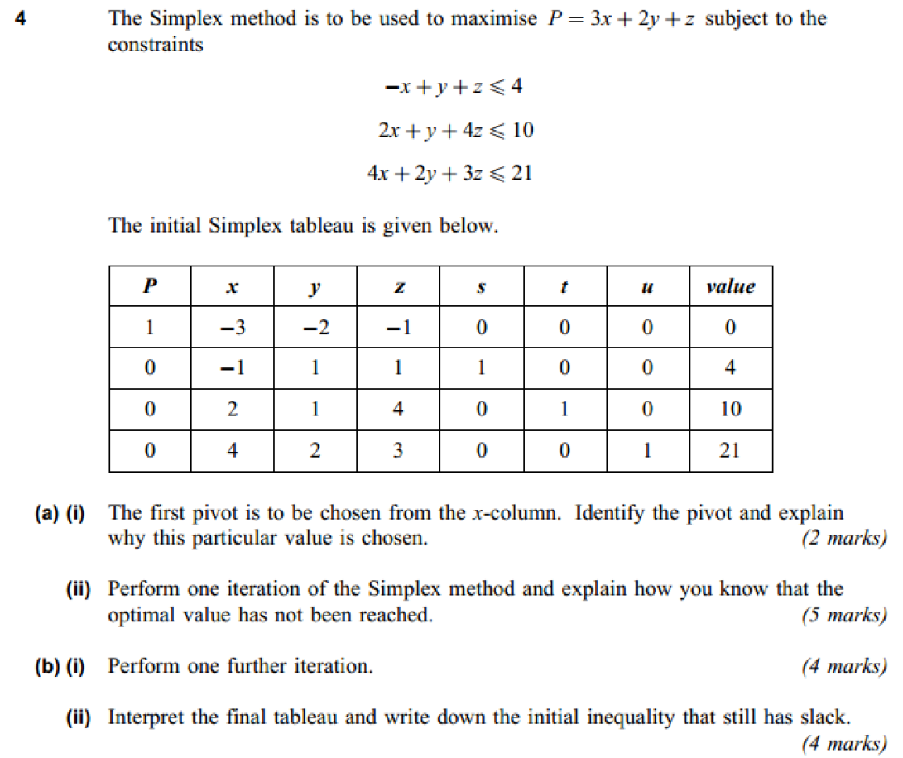

Slide 13
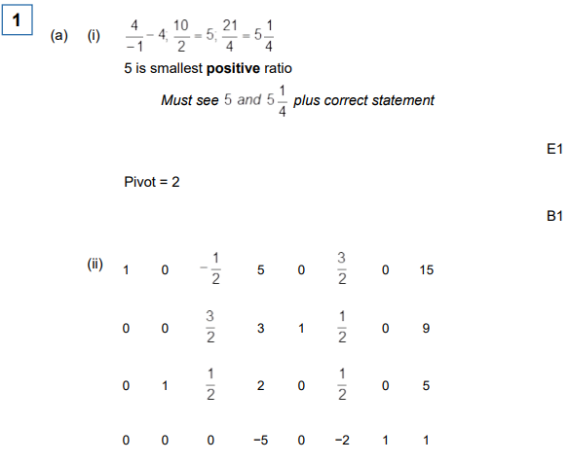

Slide 14
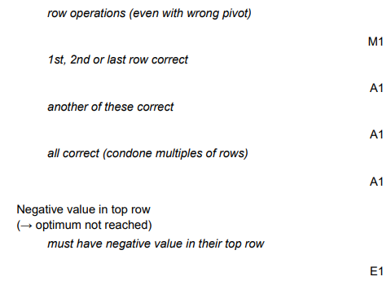

Slide 15
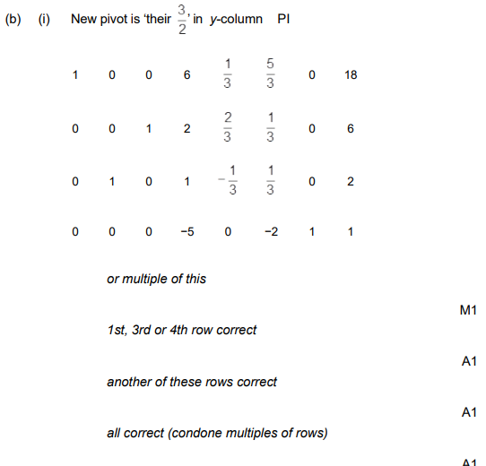

Slide 16
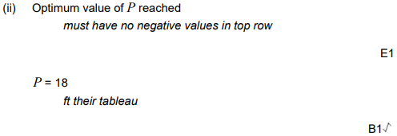
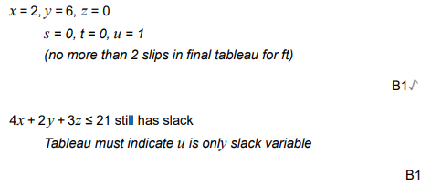

Slide 17
Simplex Algorithm Problem Solving
Complete the simplex exam questions

Slide 18
Plenary – State your confidence with each skill
Use slack variables to write a linear programming problem as a simplex tableau
Solve a maximisation problem using the simplex algorithm
Convert a minimisation problem to a maximisation problem and solve it using the simplex algorithm
What will you do to improve?

Slide 19
Homework -
Complete exercise 3.3 and self assess

