Slide 1
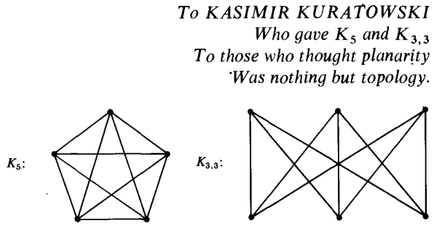

Slide 2
Isomorphisms and
Kuratowski’s Theorem
Key Words
Fluency: Recognise isomorphic graphs
Planar
Isomorphic
Vertices
Edges
Bipartite
Subgraph
Reasoning: Implement Kuratowski’s Theorem to show if a graph is planar
Problem Solving: Generate a graph based on an engineering example
Define the key words

Slide 3
Knowledge Check Fluency
Can you recall the definitions of:
Graph
Trail
Path
Cycle
Connected Graph
Simple Graph
Tree
Eulerian Graph
Hamiltonian Graph
Complete Graph
Complement
Bipartite Graph

Slide 4
Knowledge Check - ANSWERS Fluency
Graph – made of edges and vertices
Trail – a sequences of connected edges with no repeats
Path – a trail with no vertices repeated
Cycle – closed path
Connected Graph – has a path between every pair of vertices
Simple Graph – no multiple edges or loops

Slide 5
Knowledge Check - ANSWERS Fluency
Tree – a simple connected graph with no cycles
Eulerian Graph – has a closed trail with all edges
Hamiltonian Graph – has a cycle that visits all vertices
Complete Graph – every two vertices share exactly one edge
Complement – what you would add to a simple graph to obtain a complete graph
Bipartite Graph – contains two sets of vertices with edges only joining vertices from one set to the other

Slide 6
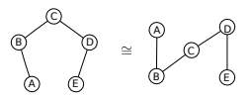
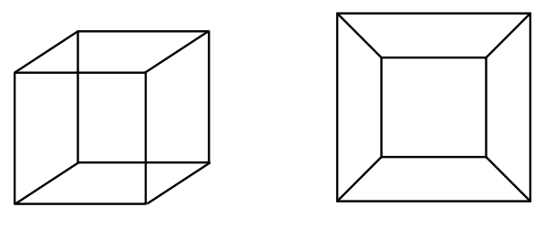
Isomorphic Graphs Fluency
Two graphs are isomorphic if they have the same structure.
Think – could I redraw this graph so it looks the same?
Complete questions 1-4 of 28.1a on sheet

Slide 7
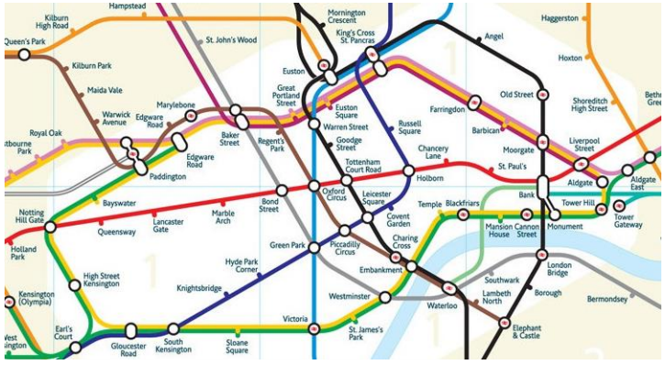
Real Life Examples of Isomorphic Graphs

Slide 8
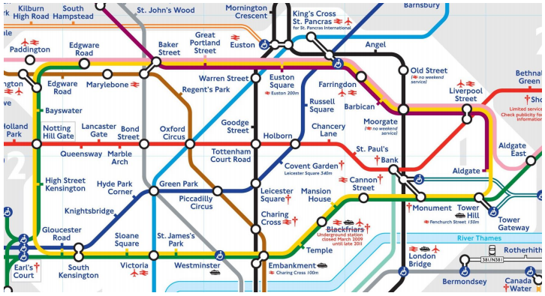
Real Life Examples of Isomorphic Graphs

Slide 9
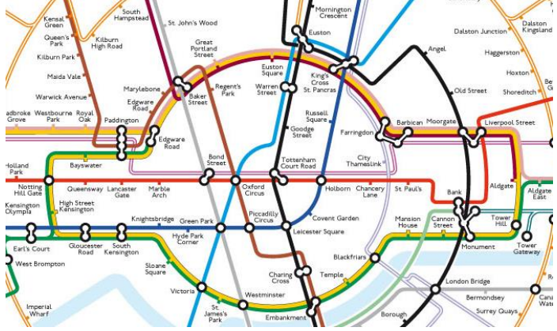
Real Life Examples of Isomorphic Graphs

Slide 10
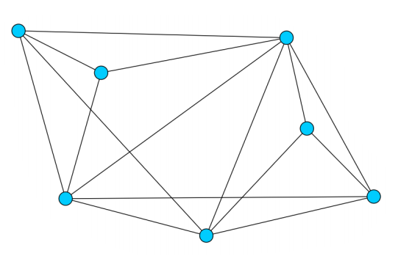
Planar Graph Reasoning
How could you redraw this graph to show that it is planar?

Slide 11
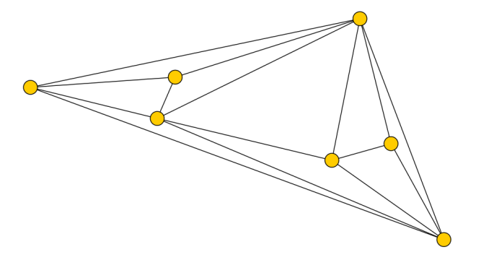
Planar Graph - Answer Reasoning

Slide 12
Kuratowski’s Theorem Reasoning
A graph is non-planar if and only if it has a subgraph which is a subdivision of $K_{5}$ or $K_{3,3}$
A sufficient proof (at A level) that a graph is non-planar is to show it contains either $K_{5}$ or $K_{3,3}$ as a subgraph.

Slide 13
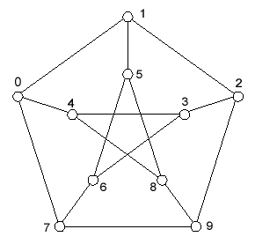
Kuratowski’s Theorem Reasoning
This is Peterson’s Graph, is it non-planar?
0
5
1
4
6
9
7
8
2
3

Slide 14
Kuratowski’s Theorem Reasoning

Slide 15
Plenary – State your confidence with each skill
Decide whether two given graphs are isomorphic
Use Kuratowski’s theorem to determine whether a graph is non-planar
What will you do to improve?

Slide 16
Homework
Complete exercise 1.5 and self assess

